Slide 1
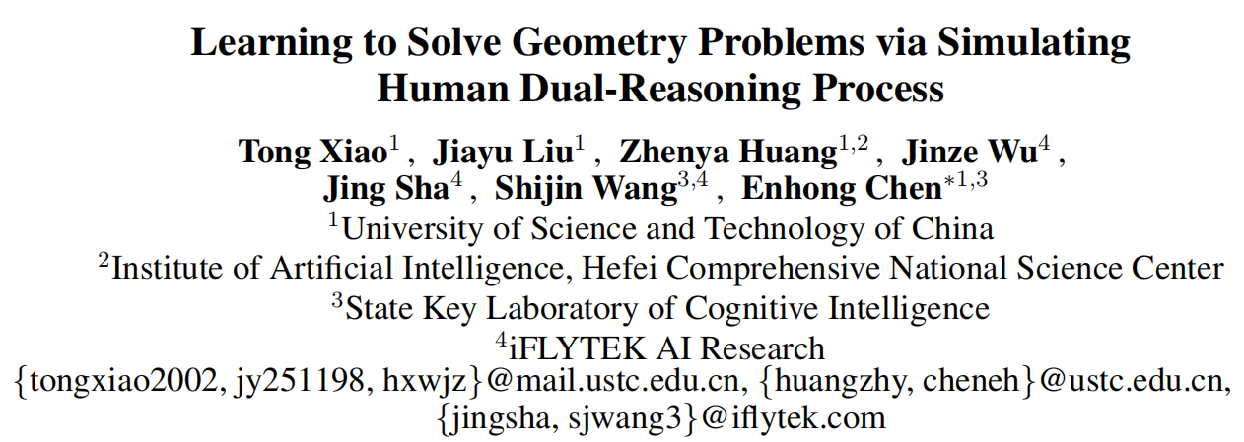
IJCAI-24

Slide 2
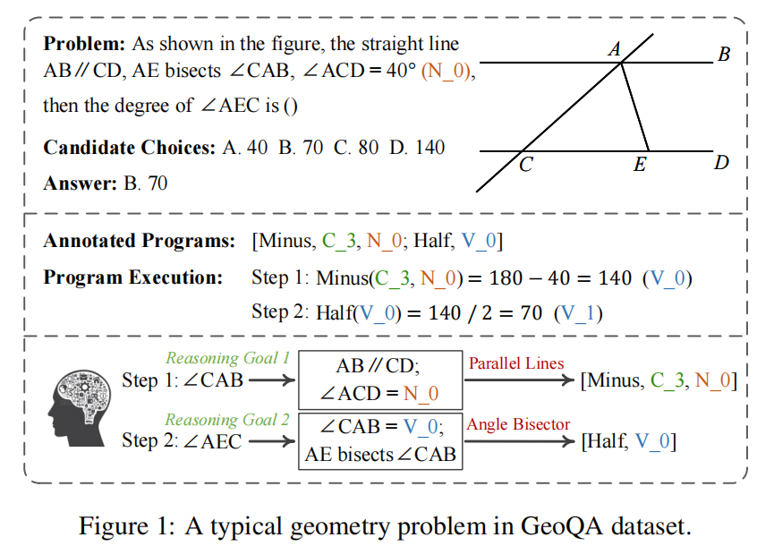
Introduction

Slide 3
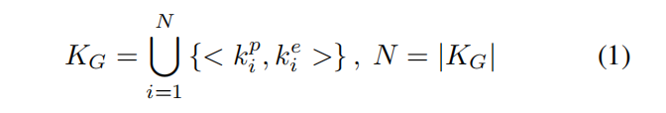
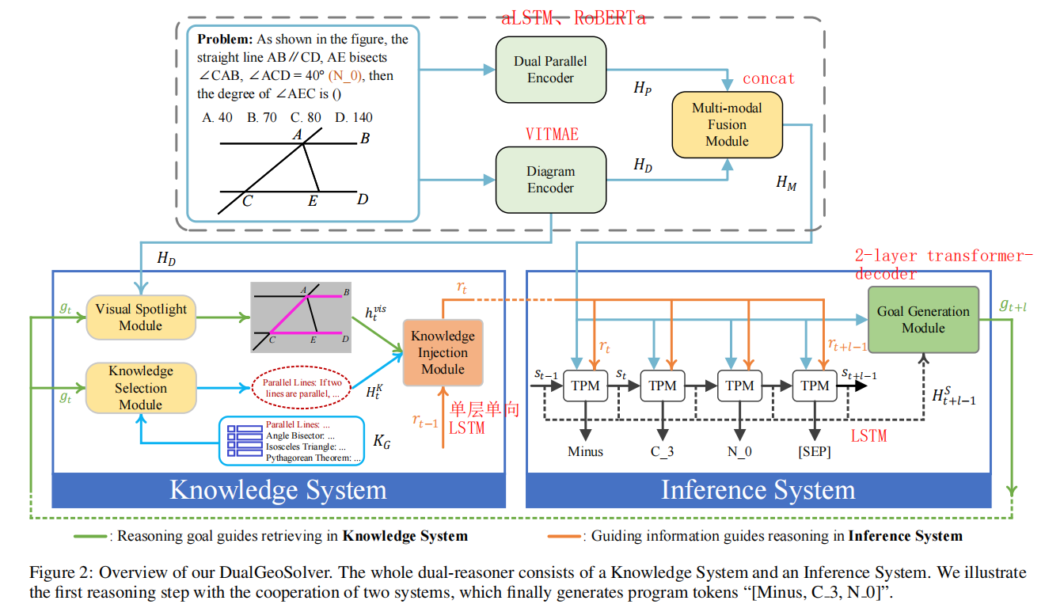
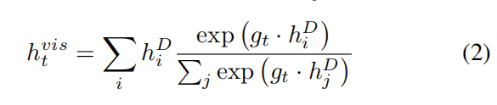
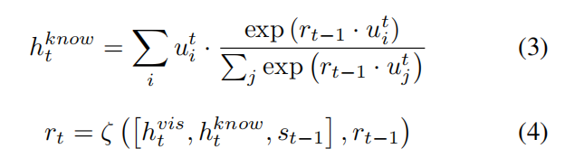



Method
(D,P,C)
VSM
KIM
token predict
Notes:
GGM: H s t+l-1 = [s0, s1, . . . , st+l−1] 作为 Q Hm 作为K V
token predict : we feed st into a linear layer with softmax function to predict the distribution of next program token Pt

Slide 4
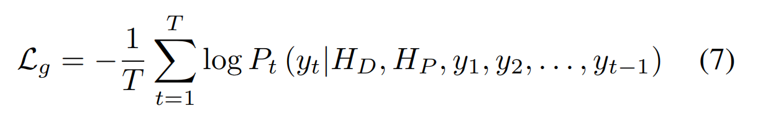
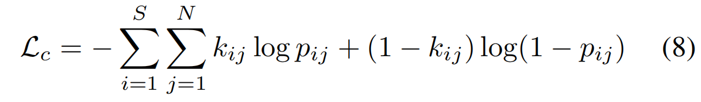

1、Token Prediction Module
2、The multi-label classification loss
Notes:
2、S 几何问题推理步骤数 N是第j个知识

Slide 5
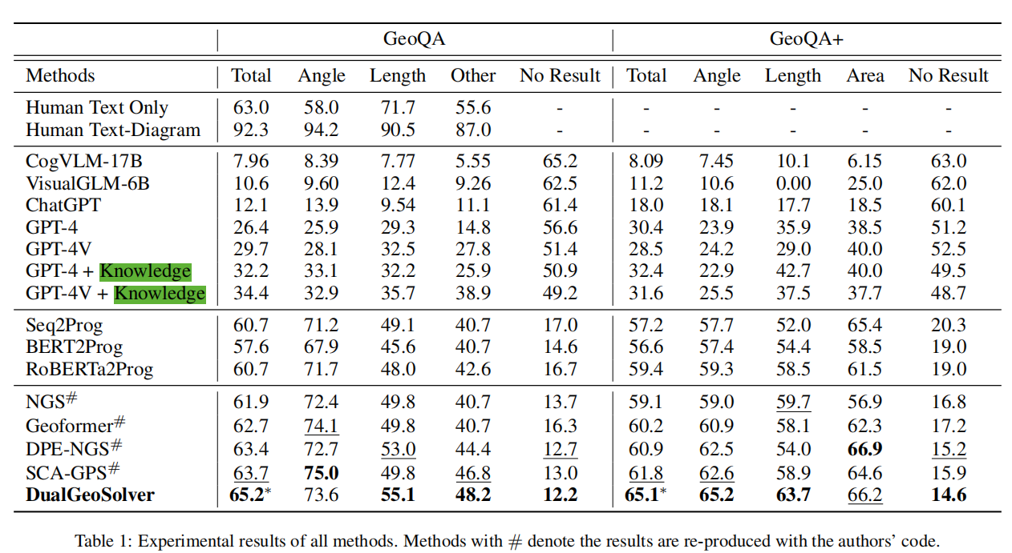
Experiments

Slide 6
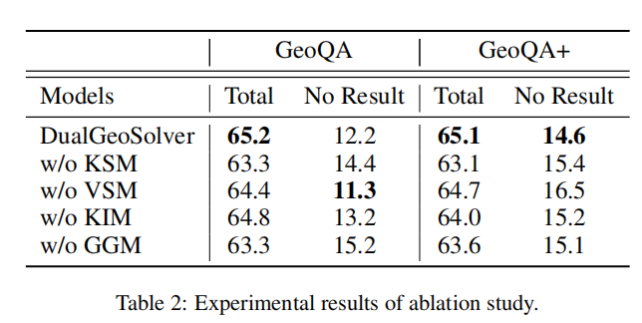

Slide 7
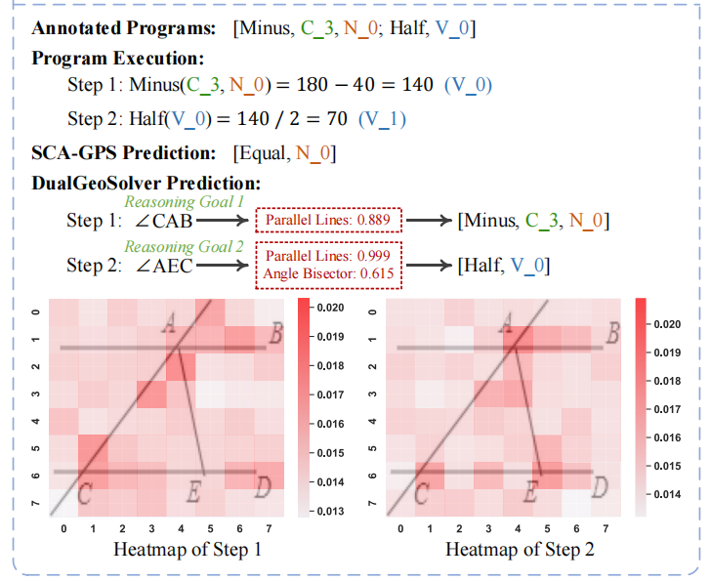
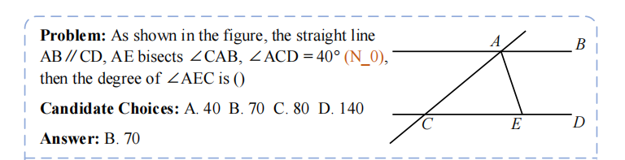

Slide 8
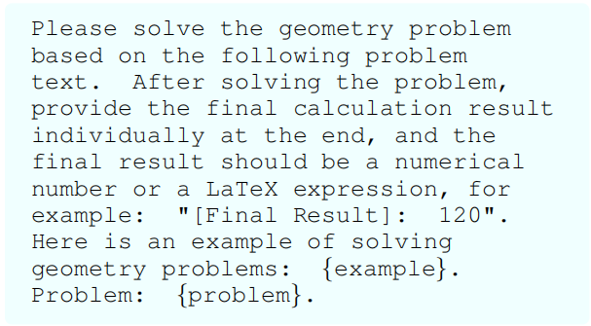
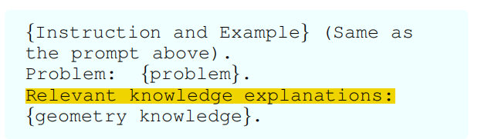
prompt

